Slide 1
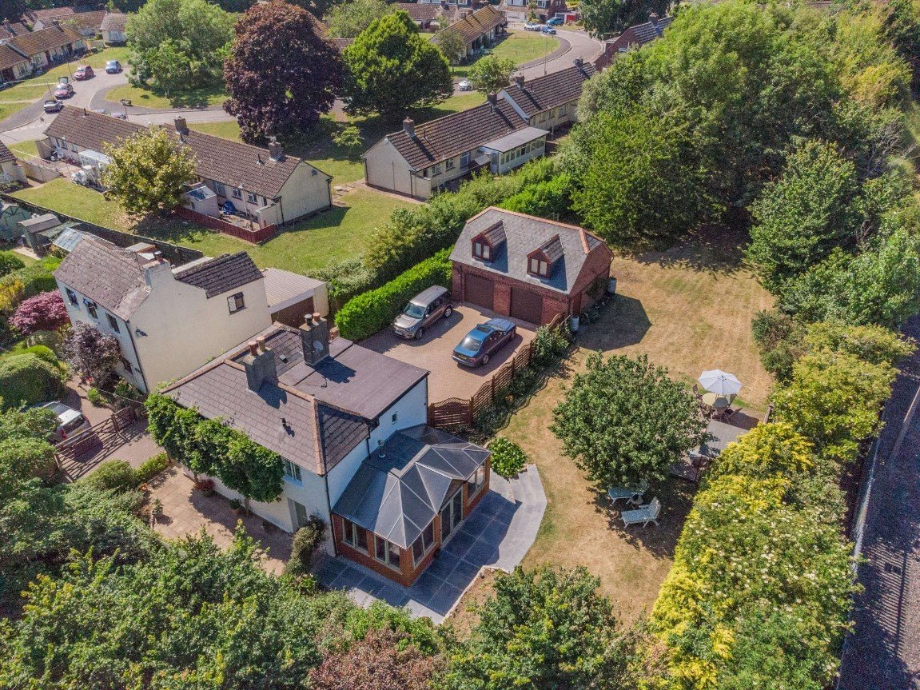
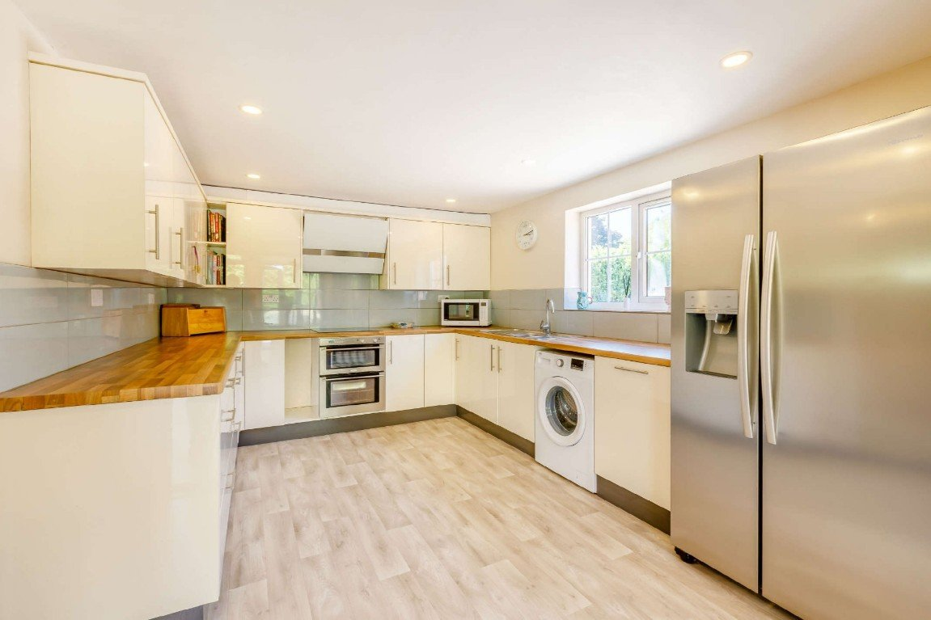
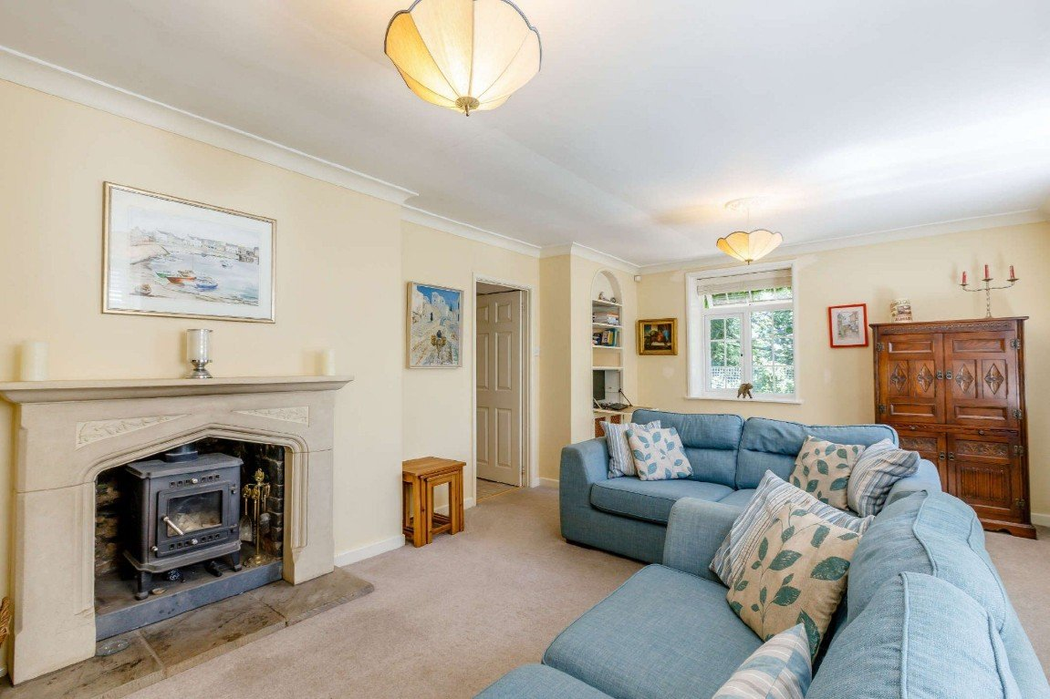
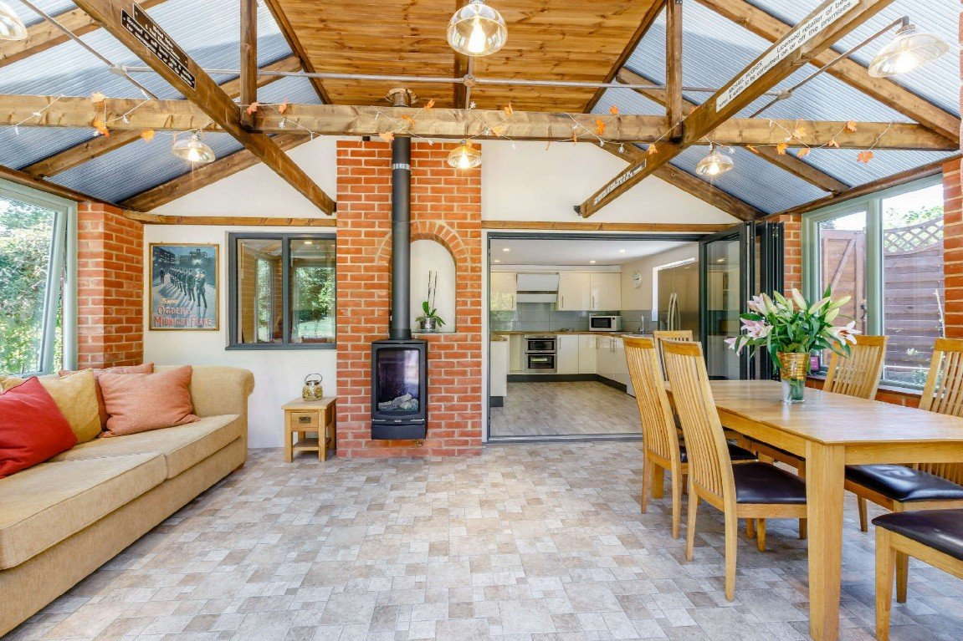
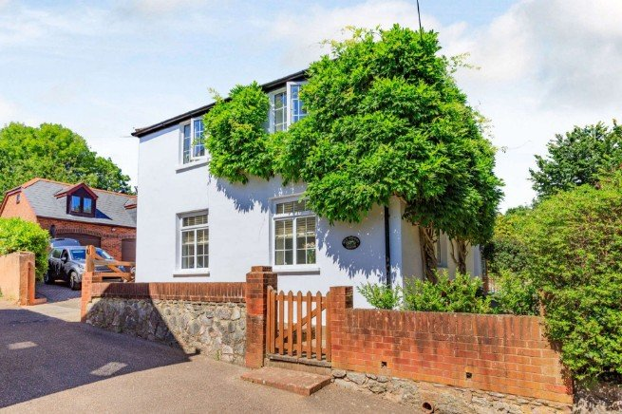
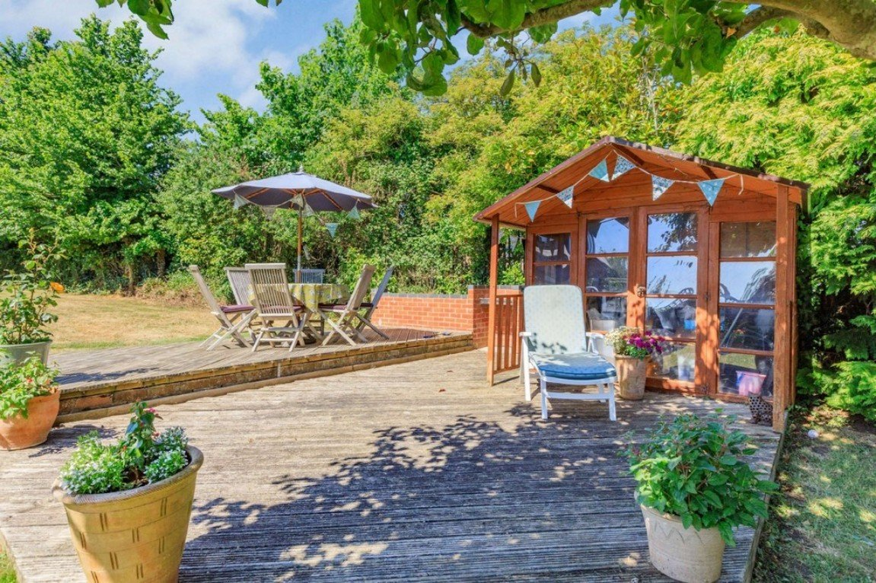
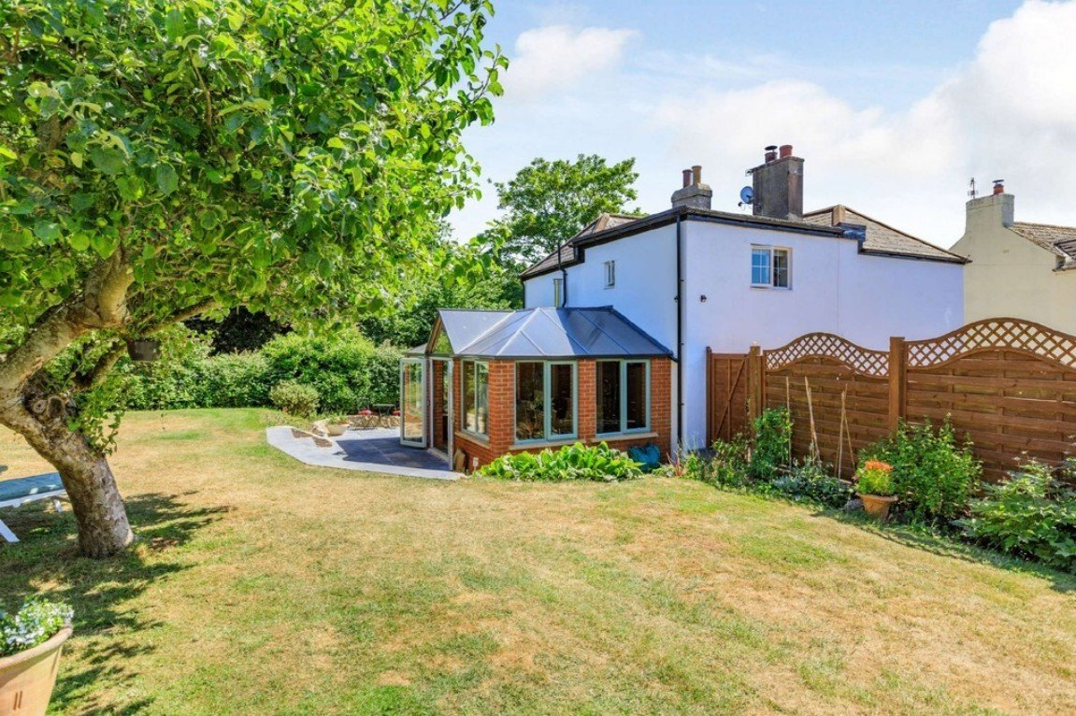
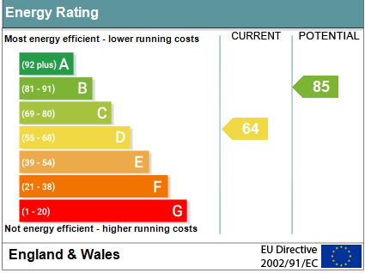
www.pennys.net
Old school house, school lane, exmouth, ex8 3AP
Offers In The Region Of: £695,000
TENURE Freehold
A Unique Opportunity To Purchase A Detached Residence Offering Much Inherent Character Standing In Grounds Of Approximately One Third Of An Acre Enjoying Ample Parking And Detached Double Garage With Studio Over
Spacious Lounge • Stylish Modern Kitchen • Sitting Room/Conservatory Extension •
Three First Floor Bedrooms – Main Bedroom With En-Suite Shower Room/WC •
Family Bathroom/WC • Wonderful Extensive Gardens •
Gas Central Heating & Double Glazed Windows • NO ONWARD CHAIN •
Pennys Estate Agents Limited for themselves and for the vendor of this property whose agents they are give notice that:- (1) These particulars do not constitute any part of an offer or a contract. (2) All statements contained in these particulars are made without responsibility on the part of Pennys Estate Agents Limited. (3) None of the statements contained in these particulars are to be relied upon as a statement or representation of fact. (4) Any intending purchaser must satisfy himself/herself by inspection or otherwise as to the correctness of each of the statements contained in these particulars. (5) The vendor does not make or give and neither do Pennys Estate Agents Limited nor any person in their employment has any authority to make or give any representation or warranty whatever in relation to this property.
PENNYS ESTATE AGENTS
2 Rolle House, Rolle Street, Exmouth, Devon, EX8 2SN
Tel: 01395 264111 EMail: help@pennys.net

Slide 2
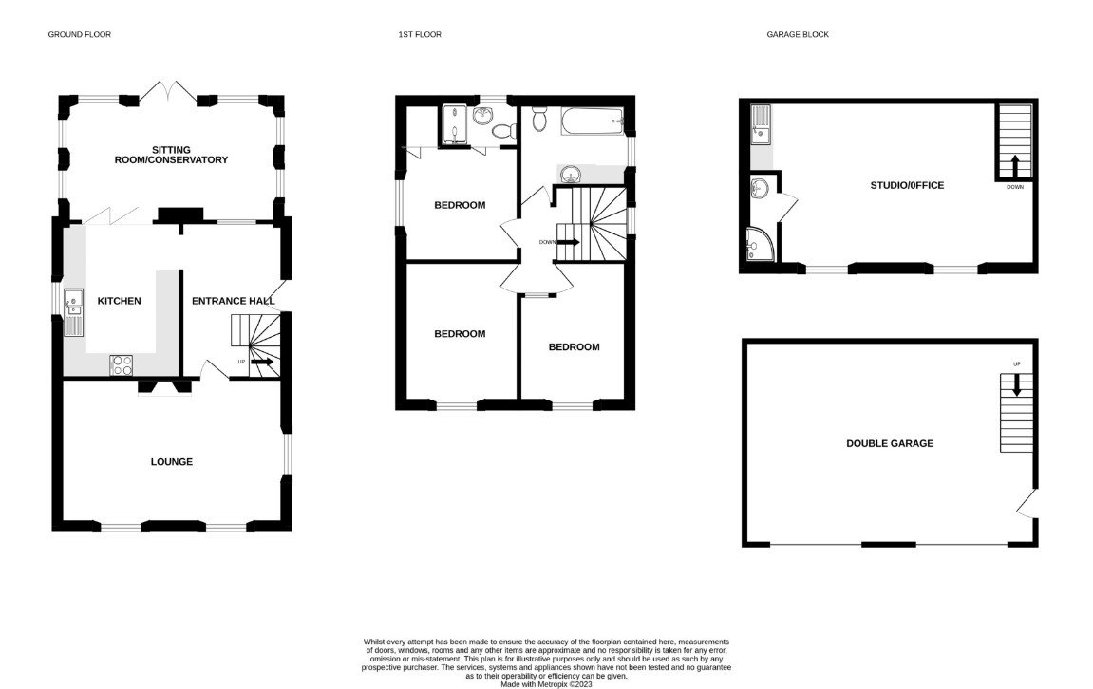
Old School House, School Lane, Exmouth, Devon, EX8 3AP
Pennys are delighted to offer for sale this former cottage school of Withycombe Raleigh village, now part of greater Exmouth. Age of original build unknown but an old map shows it on the same revision as St Micheals Church, which was demolished in 1866 to build the Withycombe Raleigh Primary School which stands at the bottom of the lane now. The property is tucked away, being at the top of a single track lane which becomes a footpath after the house, so well away from passing traffic. Note that the largest vehicle that will fit up the lane is a transit van. There is easy access to local shops, pub, bus stop, schools, etc via the lane or nearby footpath. The house has been used for home working for the last 25 years, affording separate office space and workshop without the confining feel of an estate property. The grounds are quite private, covering about one third of an acre, and have potential for a degree of self sufficiency or further development.
The wilder area of garden away from the house is recently planted as an orchard, with a variety of fruit trees and wild flowers. In Spring there are lots of bluebells and also blossom on the fruit trees and Wisteria to the front and side of the house. The accommodation has been extended over recent years and now provides wonderful family living accommodation. Outside there is parking for numerous cars/vehicles and a detached coach house with double garage and workshop downstairs, and studio over, providing an ideal environment for those needing to work from home, overflow accommodation, storage etc. The gardens are beautifully well tended with a patio sun terrace and mature flower beds and borders. Viewing of this unique property is highly recommended.
THE ACCOMMODATION COMPRISES: Composite front door with solar canopy and pir light leading into:
RECEPTION HALL: With stairs rising to the first floor landing and useful understairs storage cupboard beneath; radiator; laminate flooring; cupboard housing electric consumer unit and electric meter; coved ceiling; recess ceiling spotlighting.
LOUNGE: 5.94m x 3.78m (19'6" x 12'5") A spacious and most attractive room with three sets of uPVC double glazed windows to front and side aspects; feature Minster Stone fireplace housing log burner standing on matching hearth; television point; feature arched wall recess with shelving and cabinet; radiator; coved ceiling.
KITCHEN: 4.14m x 3.18m (13'7" x 10'5") A stylish modern kitchen fitted with a range of wood effect work top surfaces with attractive tiled surrounds; range of base cupboards, drawer units, integrated dishwasher, space and plumbing for washing machine beneath work tops; matching range of wall units at eye-level; sink unit; inset four ring induction hob with extractor hood over with light; space for American style fridge/freezer; recess ceiling spotlighting; laminate flooring; double glazed window to rear aspect; double glazed bi-folding doors opening to:
SITTING ROOM/CONSERVATORY EXTENSION: 5.61m x 3.35m (18'5" x 11'0") An excellent addition to the accommodation with exposed brick walls and wood ceiling beams; double glazed windows overlooking the gardens; "open flat" double glazed french doors opening onto the rear garden sun terrace; wall mounted glazed gas log effect fire.
FIRST FLOOR LANDING: Double glazed window on half-landing; doors leading to:
BEDROOM ONE: 3.18m x 3.02m (10'5" x 9'11") A fine main bedroom with double glazed window to rear aspect; radiator; recess ceiling spotlighting; walk-in wardrobe with clothes rail, shelf and light; door to:
EN-SUITE SHOWER ROOM/WC: A modern suite comprising of a spacious shower cubicle with splashback walls and Grohe thermostatic mixer shower unit; pedestal wash hand basin; WC with push button flush; tiled walls; recess ceiling spotlighting; double glazed window.
BEDROOM TWO: 12' 2" plus door recess x 9' 8" (3.71m x 2.95m) plus door recess. Double glazed window to side aspect; feature part sloping ceiling; radiator; access to roof space.
BEDROOM THREE: 12' 0" x 9' 9" (3.66m x 2.97m) plus doorway recess. Double glazed window to side aspect; feature part sloping ceiling; radiator.
BATHROOM/WC: 9' 0" x 7' 6" (2.74m x 2.29m) A spacious bathroom comprising of a bath with Grohe thermostatic mixer/shower attachment and shower splash screen; wash hand basin set in display surface with fitted mirror with integrated light & shaver socket over, cabinets beneath and adjoining range of matching storage cabinets housing "A" rated Potterton gold condensing combi boiler for hot water and radiators; WC; chrome heated towel rail; double glazed window.
OUTSIDE: The property enjoys a wonderful tucked away and secluded location standing in grounds we understand of approximately one third of an acre. To the front of the property there is a patio garden area with colourful well stocked flower beds which gives access through to the wonderful gardens which comprise of well-tended lawned areas edged with mature flower beds and shrubs. Timber summer house with decked area directly to the front. The well tended gardens extend to a wildlife garden area which is home to an array of wildlife with orchard and surrounding trees. From this area a pedestrian side gate gives access to a pedestrian lane. To the rear of the property there is a gated entrance giving access to a large block paved parking area for numerous cars which in-turn gives access to a:
LARGE DETACHED DOUBLE GARAGE with STUDIO over: With twin remote control doors; large fixed work-bench; racking; lighting; plentiful sockets; tap near door.
FIRST FLOOR STUDIO/OFFICE: 24' 10" maximum x 12' 3" (7.57m x 3.73m) measurement excluding two dormer window recesses which overlook the house and garden; two double glazed Velux windows; sink unit set in work surface with cupboards beneath; wood effect laminate flooring; recess ceiling lighting; ample power sockets; door to:
SHOWER ROOM/WC: Comprising of a tiled shower cubicle with shower unit; WC; part sloping ceiling; double glazed window.
DIRECTIONS: The property is at the top of a single track lane. Come past the terraced houses on the left and continue up the tree-lined section. This opens out further up and Old School House is on the right. There are schools, shops, pub, and bus stops not far from the bottom of the lane, and a doctors surgery rated outstanding by CQC about 20 mins walk away. Town centre and railway station are about 25 mins on foot.

